Slide 1


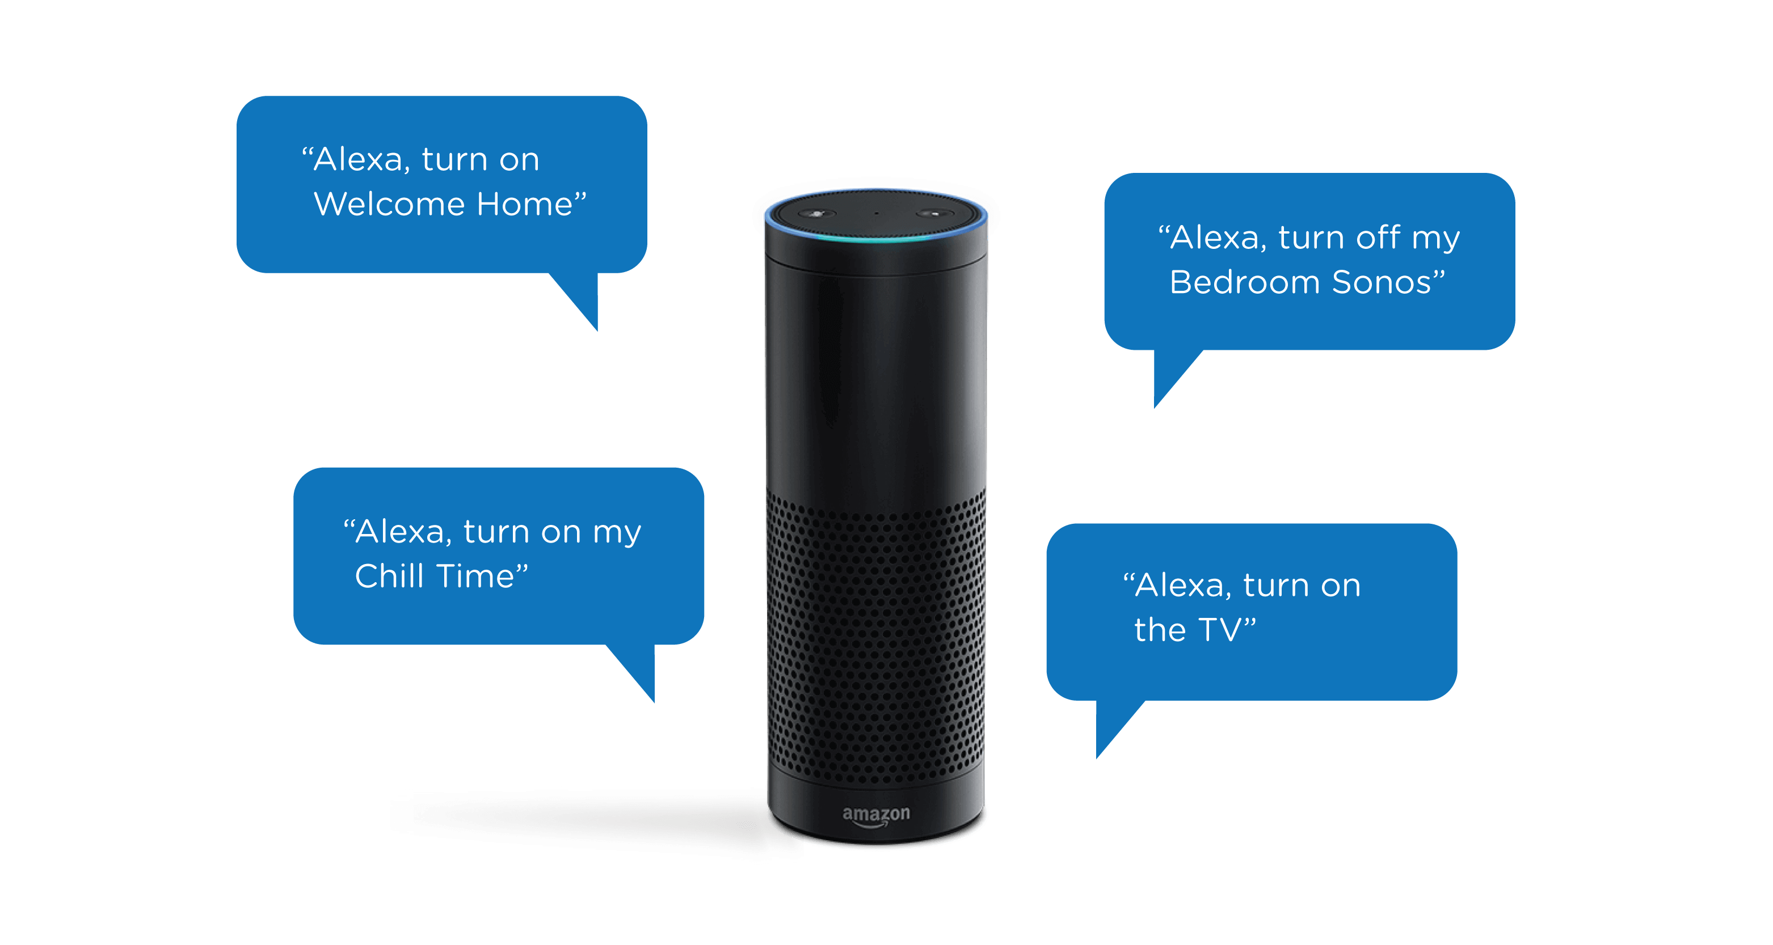
“Alexa, turn on the Ajax Bot”
“Alexa, use GM module 1 on Ajax Bot”
“Alexa It’s Team, ‘AJAX’
Members:
YASH CHAUHAN
ROHAN MUJOO
MOHIT JAIN
MAHIMA KOTHARI

Slide 2


Problem Statement
“We want to revolutionize the way education is imparted by using voice technologies. How can AI of Amazon Alexa can be leverage to build engaging skills to make learning a fun experience from students from kindergarten to professional courses? The skill built on Amazon Alexa should work as a, “Virtual Teacher” and help students with everyday activities involved during their student years like searching for content, curriculum management, personal evaluation, subject-wise coaching and more.”
Our Solution/Approach to The Problem
We plan on making an extension for Alexa that will be the main learning module and would be able to interact and teach kids all the information present on the module in a fun and interactive way.
Controls
OUR DEVICE
(ALEXA EXTENSION)
Has Educational Modules
Interacts with
Commands
Teaches
Echo dot
Kids

Slide 3
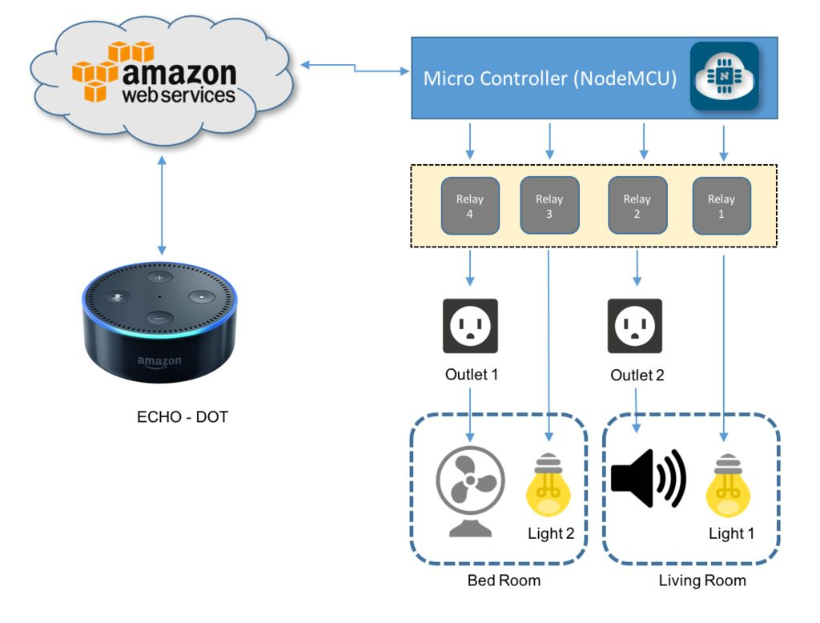
Salient Features
Relay Channels
MODULE : 2
MODULE
: 1
Easily accessible.
Built while keeping in mind the short attention span of young kids.
Interactive and fun with MCQ question.
Can be loaded with multiple modules at once as per the requirement of the user.

Slide 4
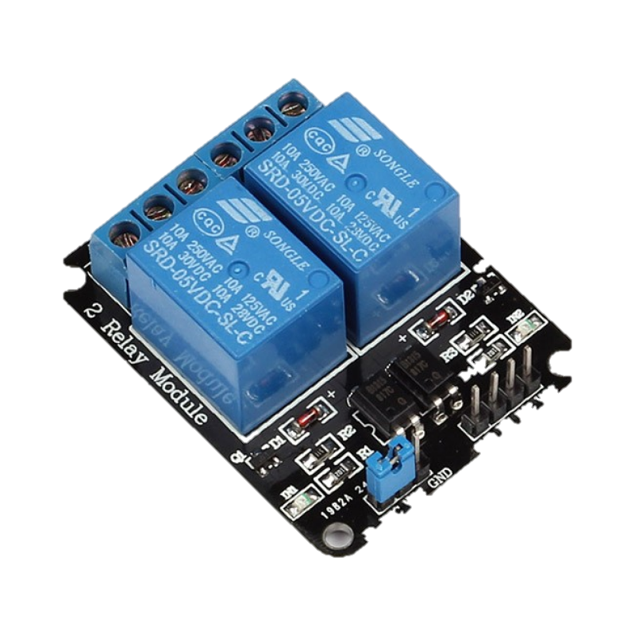

COMPONENTS USE IN OUR PROJECT
Relay Module : Introducing the Relay Module. A relay is an electrically operated switch of mains voltage. It means that it can be turned on or off, letting the current go through or not. Controlling a relay with the Arduino is as simple as controlling an output such as an LED. The relay module is the one in the figure below
2.Amazon Echo : Amazon Echo (shortened
and referred to as Echo) is a brand of smart speakers developed by Amazon.com. The devices connect to the voice-controlled intelligent personal assistant service Alexa, which responds to the name "Alexa". This "wake word" can be changed by the user to "Amazon", "Echo" or "Computer".

Slide 5
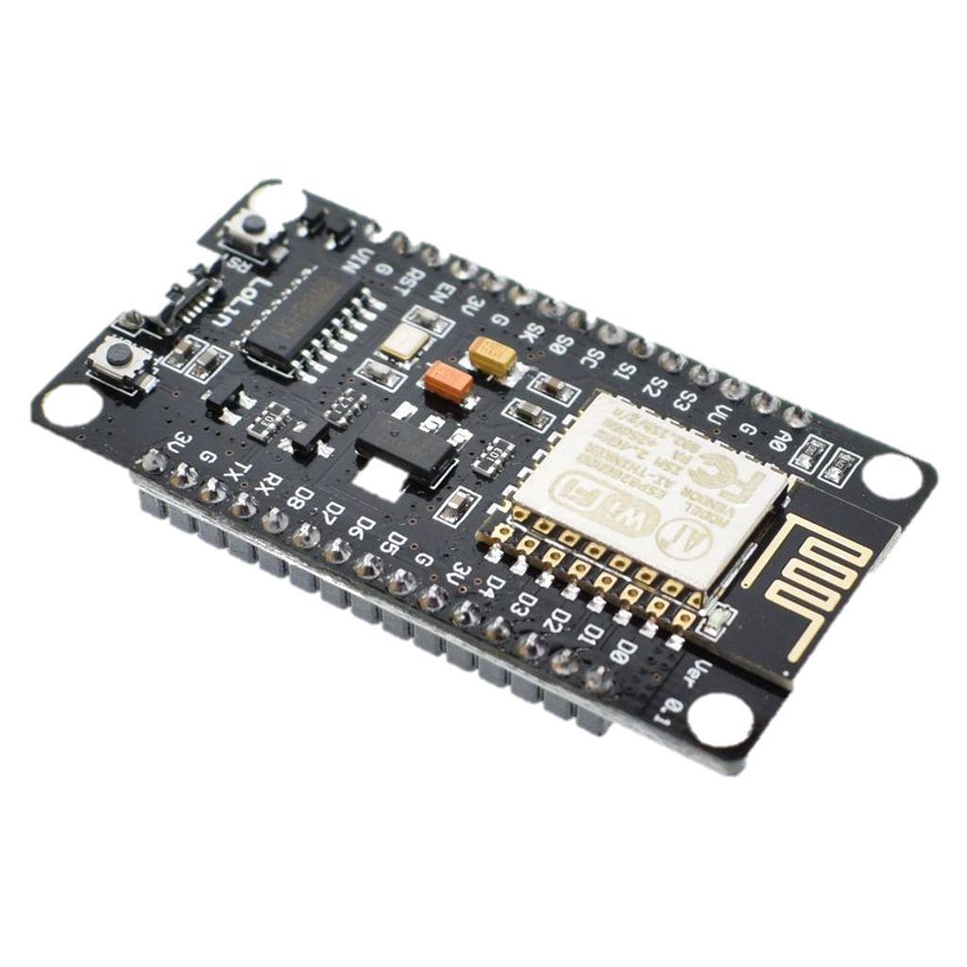
3.NodeMCU : NodeMCU is an open source IoT platform. It includes firmware, which runs on the ESP8266 Wi-Fi SoC from Espssif Systems, and hardware which is based on the ESP-12 module. The term "NodeMCU" by default refers to the firmware rather than the development kits. The firmware uses the Luascripting language. It is based on the eLua project, and built on the Espressif Non-OS SDK for ESP8266. It uses many open source projects, such as lua-cjson, and spiffs.

Slide 6

Our Future Plans
First and foremost.
What is Gururkul Model?
We, Team Ajax plan on working with an educational start-up (OxYmora Technologies Pvt Ltd; Backed by 38 NGOs) , that aims to provide a more practical approach towards education by emphasizing more in the practical and applied knowledge rather than rote learning that is popular.
We plan to implement the ideas of this model in our product that we are developing for this hackathon thus making a contribution towards both the youth of this country and also the company we have been working with.

Slide 7




